Slide 1
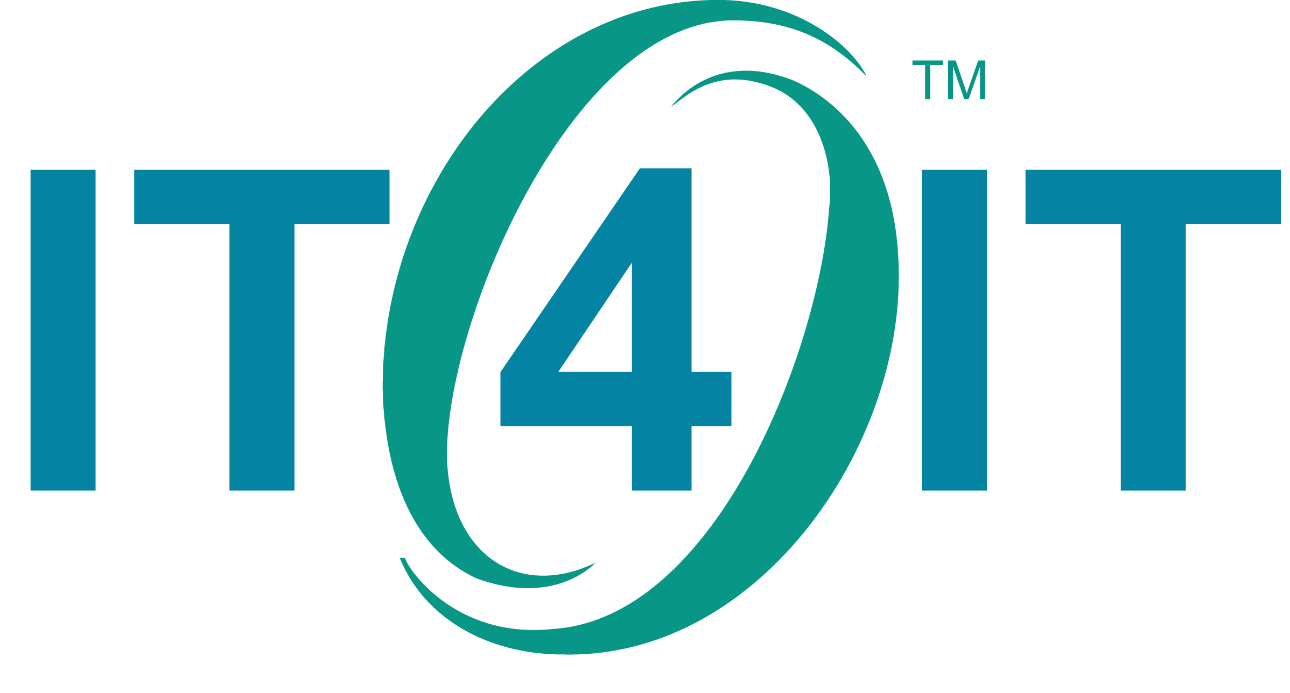
Drive Business Value
from IT4IT

Slide 2
How Could I?
Retain Talent
Have an Agile
Business
Manage Growth
Drive Innovation
Have Responsive
IT
Create new products faster
Notes:
As organizations face competing pressures to evolve in the digital marketplace, the role of the CIO’s is coming under greater scrutiny and pressure to provide greater value, faster and with lower risk. Ongoing IT management challenges along these lines are now urgent objectives for the organization to succeed, closing the gap between the business and IT to the point there is little separation between the 2. The challenge for the contemporary CIO is figuring out how to rise to the occasion, and meet these objectives head-on.

Slide 3
IT4IT: A Language for Digital Transformation
The journey to the Digital Enterprise requires a strategy
Legacy
A managed and metered Service Model approach enables true Portfolio Management
ERP-like functional flow improves financial control and allows fine-grained, usage-based chargeback
The Value Chain model supports end-to-end focus on outcomes
A standards-based operating model shifts IT effort from factory design to value delivery
Service Model approach enables effective IT Portfolio Management
Supports transition to Agile, LeanIT, DevOps, BiModal
The Value Chain model supports end-to-end focus on business outcomes
Standards-based operating model shifts IT effort to value delivery
Notes:
Most CIOs struggle evolve their legacy IT organization to run more like a business, leading the way for a digital transformation. CIOs know that when you don’t think of IT as an extension of the business, business partners will bypass IT altogether and “going digital” is next to impossible.
Turning the corner starts with IT having the proper focus on what value IT provides, acutely focusing on maximizing value while minimizing cost and risk, just like any business would.
IT must also be laser focused on deploying or brokering the right strategic services to fuel digital business growth. IT must be able to embrace new roles and functions that know how to focus on delivering services automatically, removing bureaucracy and bottlenecks along the way and ensuring that interaction with IT is a meaningful experience for IT service consumers. Lets face it, most IT organizations haven’t focused on business outcomes and customer experience, forcing many to bypass IT altogether.
While IT4IT isn’t a silver bullet, it was created to address this very problem as an important tool for any CIO in any organization.

Slide 4
Next generation IT management addresses concerns
Efficiency
Agility
Strategy alignment to value
Respond to changing markets
Reduce risk
Faster time to market
Supports transparency
Value based cost controls
Plan
Build
Deliver
Run
Pay as you go pricing model
Catalog offerings
Transparent pricing
Respond to customer demand
Fast issue resolution
Feedback sets strategy
4
Notes:
<<I would typically build this slide out, starting with Plan, then Build, then Deliver, the Run>>
Introducing IT4IT, the next generation IT management approach focused on automation and all the contemporary CIO concerns for a digital transformation. The traditional plan, build, run IT organization has been re-defined into 4 values treams: Plan, Build, Deliver, and Run.
<<Build out strategy>>
This comprehensive approach started with Plan, now defined as Strategy to Portfolio focused on aligning the IT strategy with the business, and investing in creating the the service portfolio the business needs to achieve business outcomes.
<<Build out Build>>
Build is your typical SDLC now known as Requirements to Deploy, focusing on building or brokering IT services that are required. This includes waterfall and agile teams who are under pressure to new services faster and at lower cost.
<<Build our Deliver>>
The introduction of the Deliver, or Request to Fulfill, addresses the need for IT to deliver standardized IT services as a main capability vs. how IT has typically provided services in disparate catalogs based on the type of resource. Implementing a comprehensive catalog and shopping experience, providing transparent pricing, and automating deliver are some of the main objectives of Delver to keep the IT organization focused on continuously delivering value.
<<Build Run>>
Run is your typical break fix and help desk activity that deals with keeping the lights on, referred to as Detect to Correct. Ideally through automation, most events can be mitigated by detecting failures early, preventing service interruption entirely, again through automation.
Implementing all 4 value stream you can expect to achieve efficiency and agility that your organization requires in the digital business era.

Slide 5
IT4IT Success Stories
Shell
Simplified complex IT process and tool landscape
Improved governance
Reduced number of IT vendors
Rabobank
Bridged both IT and business silos
Enabled genuine collaboration on business function automation
Better time to market
Exxon Mobil
Applied Value Chain thinking to IT management.
Increased automation in IT operations
Safeway
Cut vendor management overhead
FedEx
Moved to shorter planning cycles
Managing and controlling service consumption
Reduced IT spend
Retired ~130 applications
Introduced continuous build and deploy
Notes:
Here are a number of early adopters who have applied IT4IT within their own IT organizations. While use case between organizations vary, all can agree that IT4IT of value. Here are a few highlights:
Shell was a founding member of the IT4IT consortium and has been incorporating the insights gained since the very beginning.
Rabobank was also involved in the creation of IT4IT from early on, and has integrated the standard into the fabric of IT.
Exxon Mobil joined the forum just after the IT4IT standard was published, and has started to align multiple teams across multiple siloes leveraging the comprehensive framework
Safeway and HPE benefit were able to collaborate leveraging the IT4IT Reference Architecture, identifying millions in potential savings
FedEx attended one of the Safeway presentations and within one year created their own success story by leveraging IT4IT to help increase IT agility in responding to business demand through improved functional automation & integration

Slide 6
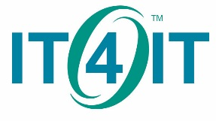
The IT4IT Reference Architecture provides context to understand and act upon existing data in business value terms
Notes:
The IT4IT standard is open, allowing anyone to leverage the standard and aggregating feedback from the masses. I invite you and your team to learn more about what the IT4IT standard can do for you, and to contribute to one of the most important evolutions to the business of IT to happen in many years.

